Slide 1


Slide 2
DBMS Concepts and SQL

Slide 3
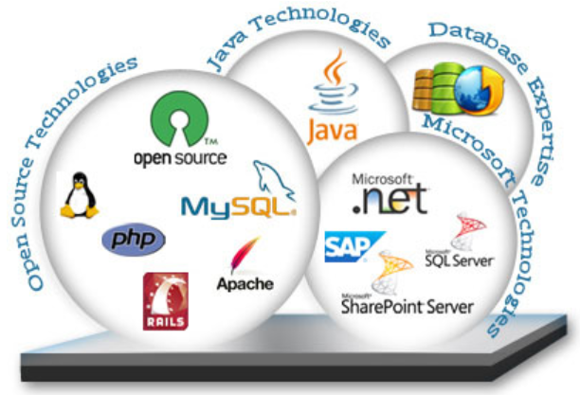






Slide 4

Traditional File Based System
Employee Application
Employee File
Name,Address,Designation
Payroll Application
Payroll File
Name,Address,Hours Worked,Pay Rate
Benefits Application
Benefits File
Name,Address,Hours,Insurance,Pension

Slide 5
Limitations
Data Redundancy
Inconsistent Data
Difficulty in Accessing Data
Limited Data Sharing
Concurrent Access
Atomicity

Slide 6
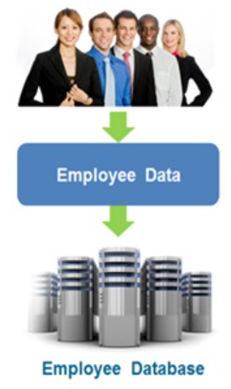
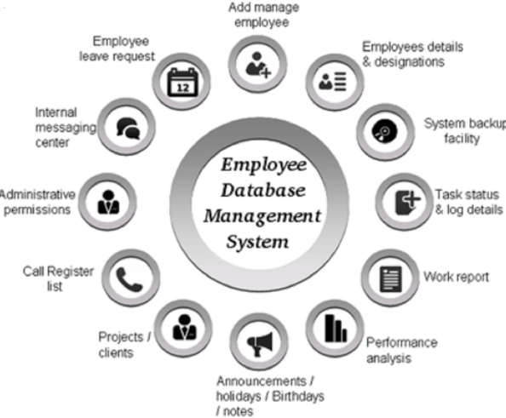
Database Management System
Database is a collection of inter-related data which helps in efficient retrieval, insertion and deletion of data from database and organizes the data.

Slide 7
Database Application
Banking
Airlines
Universities
Telecommunication
Finance
Sales
Manufacturing
HR Management

Slide 8
ACID Properties
A - Atomicity
All or None Transaction
C - Consistency
Database must be consistent before and after the transaction
I - Isolation
Transactions are Independent
D - Durability
Committed data is never Lost

Slide 9
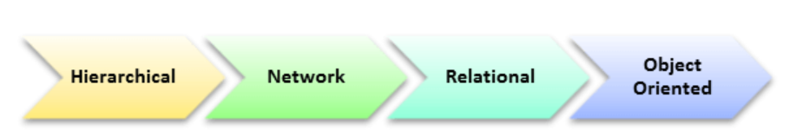
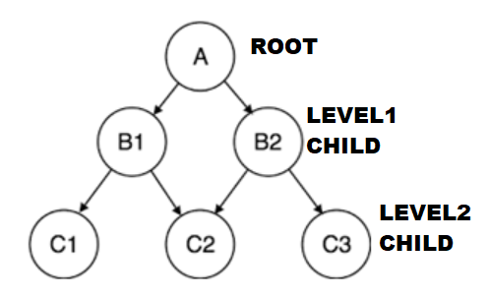
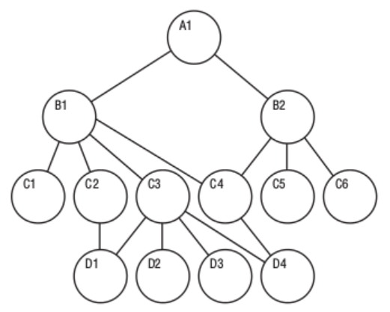
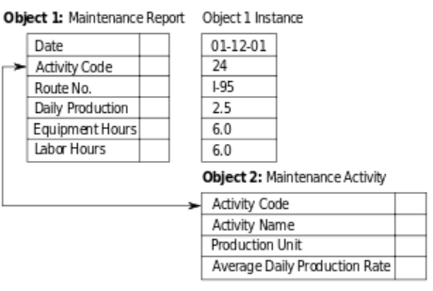
Database Models
RollNo | Name | City | Age
100 | Sai | Chennai | 19
101 | Preethi | Madurai | 20

Slide 10
Relational Model
RELATIONAL MODEL (RM) represents the database as a collection of inter related Tables
TableName:Student
Attribute/Column
RollNo | Name | City | Age
100 | Sai | Chennai | 19
101 | Preethi | Madurai | 20
102 | Kim | Pune | 19
Tuple/Row/Record
Domain

Slide 11
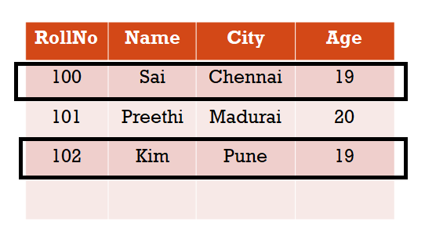
Data Design and Normalization
Entity:
An entity is a real-world thing which can be distinctly identified like a person, place or a concept
Eg: School Database, Students, Teachers, Classes, And Courses offered
Entity Type:
The entity type is a collection of the entity having similar attributes
Entity Set:
Collection of one or more entity of same Entity type
TableName:Student
Entity Type
Display the student details whose age is 19
Entity 1
Entity Set
Entity 1
Entity 3
Entity 2
Entity 3

Slide 12
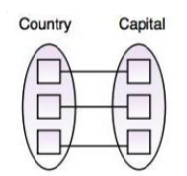

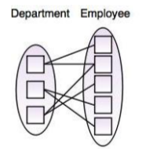
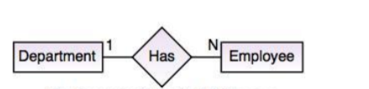
Data Design and Normalization
Types of Relationship Mapping
One - to - One Relationship
One - to - Many Relationship

Slide 13
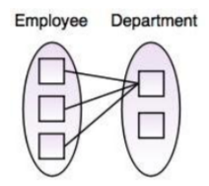
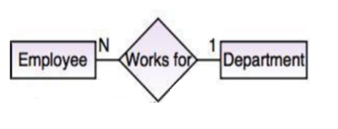
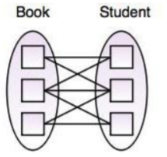
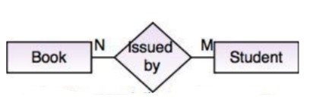
Data Design and Normalization
Many - to - One Relationship
Many - to - Many Relationship

Slide 14
Data Design and Normalization
Normalization
Normalization is a process or a technique which is used to reduced or decompose the redundancy(repetition) and insertion anomaly, update anomaly & deletion anomaly
Anomalies in DBMS
emp_id | emp_name | emp_address | emp_dept
101 | Rick | Delhi | D001
101 | Rick | Delhi | D002
123 | Maggie | Agra | D890
166 | Glenn | Chennai | D900
166 | Glenn | Chennai | D004

Slide 15
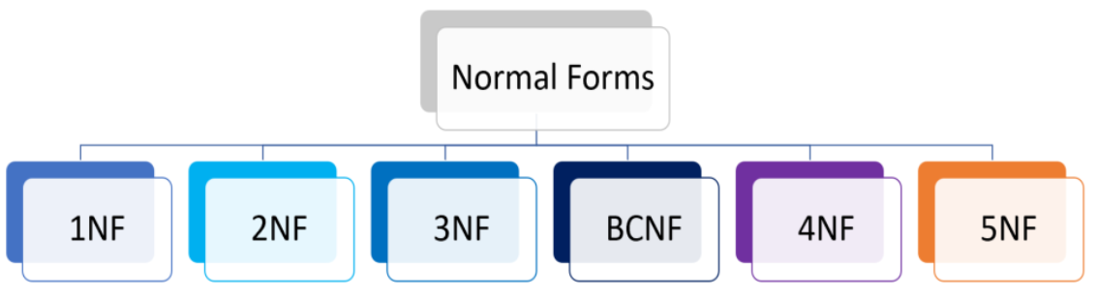
Normalization

Slide 16
Normalization
Example
Table : Employee
Id | Name | MobileNo | Salary | AnnualIncome | DeptId | DeptName
100 | Suresh | 9952836879, 7889012345 | 35000 | 4,20,000‬ | 1 | Finance
101 | Abi | 8901234567,6789012345 | 50000 | 6,00,000‬ | 2 | Development
102 | Banu | 7890123456, 8901235670 | 45000 | 5,40,000‬ | 2 | Development

Slide 17
Normalization
1st Normal form
It should only have single(atomic) valued attributes/columns.
Attribute Domain should not change
Table : Employee
Id | Name | MobileNo1 | MobileNo2 | Salary | Annual Income | DeptId | DeptName
100 | Suresh | 9952836879 | 7889012345 | 35000 | 4,20,000‬ | 1 | Finance
101 | Abi | 8901234567 | 6789012345 | 50000 | 6,00,000‬ | 2 | Development
102 | Banu | 7890123456 | 8901235670 | 45000 | 5,40,000‬ | 2 | Development

Slide 18
Normalization
2nd Normal form
It should be in the First Normal form.
And, it should not have Partial Dependency.
Table : Employee
Table : Dept
Id | Name | MobileNo1 | MobileNo2 | Salary | Annual Income
100 | Suresh | 9952836879 | 7889012345 | 35000 | 4,20,000‬
101 | Abi | 8901234567 | 6789012345 | 50000 | 6,00,000‬
102 | Banu | 7890123456 | 8901235670 | 45000 | 5,40,000‬
DeptId
1
2
3
DeptId | DeptName
1 | Finance
2 | Development
3 | Development

Slide 19
Normalization
3rd Normal form
It is in the Second Normal form.
And, it doesn't have Transitive Dependency.
A -> B,B -> C,C ->A
Table : Employee
Table : EmployeeSalary
Id | Name | MobileNo1 | MobileNo2
100 | Suresh | 9952836879 | 7889012345
101 | Abi | 8901234567 | 6789012345
102 | Banu | 7890123456 | 8901235670
DeptId
1
2
3
Id
100
101
102
Salary | Annual Income
35000 | 4,20,000‬
50000 | 6,00,000‬
45000 | 5,40,000‬

Slide 20
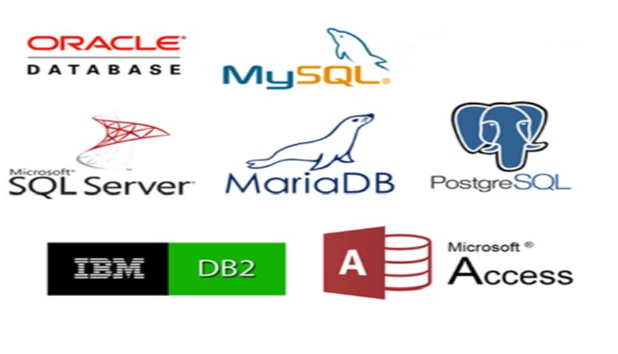
Some Popular database

Slide 21
Sql Server
Microsoft SQL Server 2012 is a full-featured relational database management system (RDBMS) that offers a variety of administrative tools to ease the burdens of database development, maintenance, and administration

Slide 22
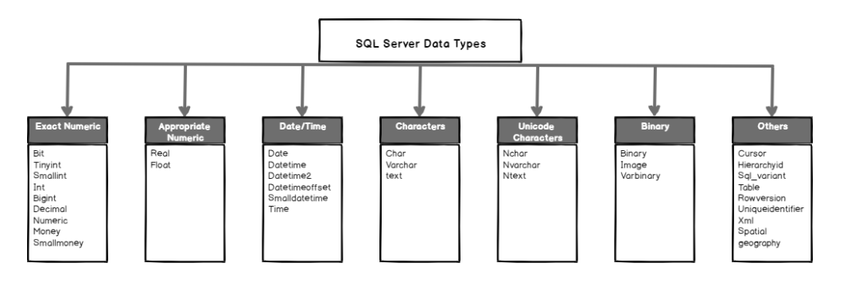
Sql Server Data Types

Slide 23
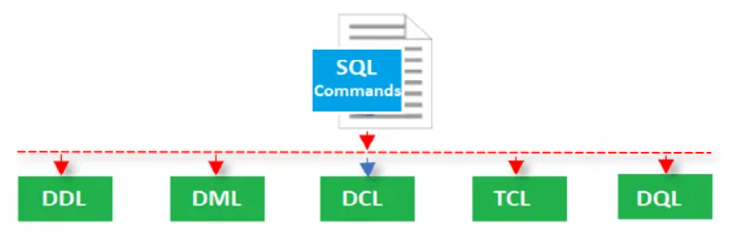

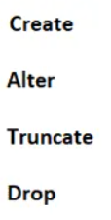
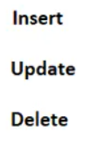
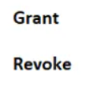
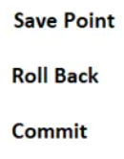

Structured Query Language and its categories

Slide 24
Data Definition Language
CREATE –Create a database, table, triggers, index, functions, stored procedures, etc.
DROP – This SQL DDL command helps to delete objects. For example, delete tables, delete a database, etc.
ALTER – Used to alter the existing database or its object structures.
TRUNCATE – This SQL DDL command removes records from tables
RENAME – Renaming the database objects

Slide 25
Constraints
Constraints are the rules enforced on the data columns of a table
This ensures the accuracy and reliability of the data in the database.
Sql Server constraint are as following
Not Null
Unique Key
Primary key
Check Constraints
Default
Foreign Key
Disabling Constraints

Slide 26
Data Manipulation Language
SELECT –Select records or data from a table
INSERT– Insert data into a database table.
UPDATE –Update existing records within a table
DELETE – Delete unwanted records from a table

Slide 27
Joins
JOINS are used to retrieve data from multiple tables
TYPES
There are 4 different types of SQL Server joins:
SQL Server INNER JOIN (or sometimes called simple join)
SQL Server LEFT OUTER JOIN (or sometimes called LEFT JOIN)
SQL Server RIGHT OUTER JOIN (or sometimes called RIGHT JOIN)
SQL Server FULL OUTER JOIN (or sometimes called FULL JOIN)

Slide 28
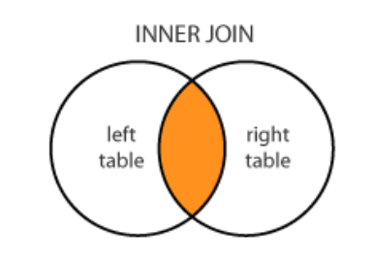
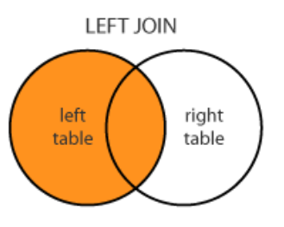
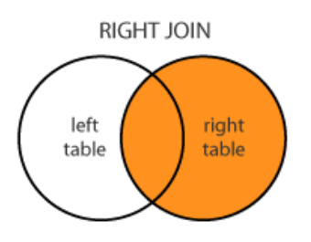
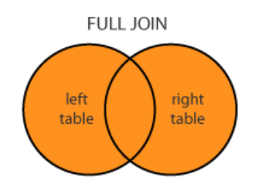
JOINS

Slide 29
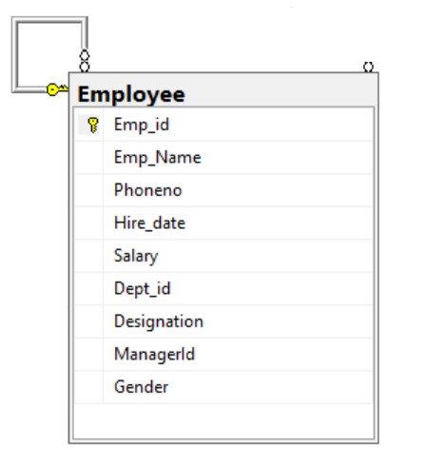
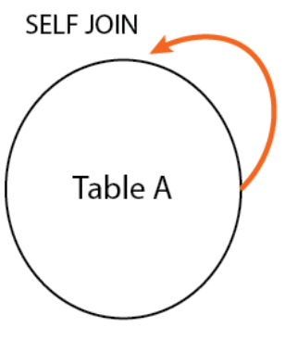
Joins

Slide 30
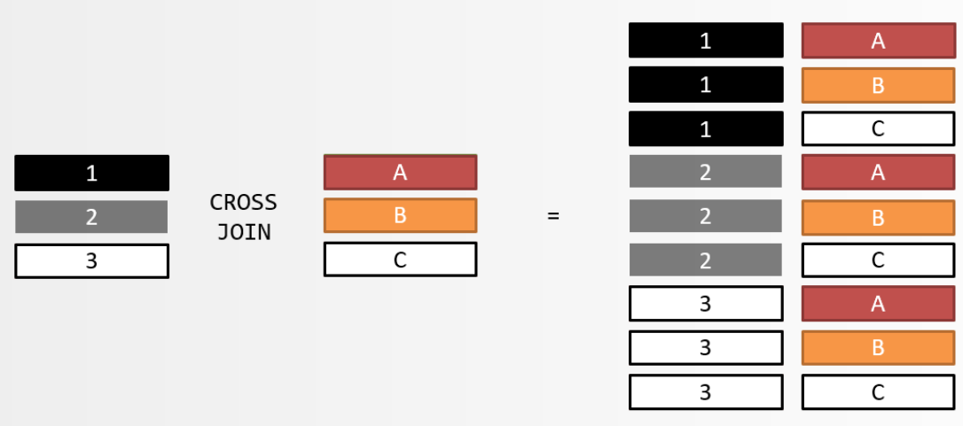
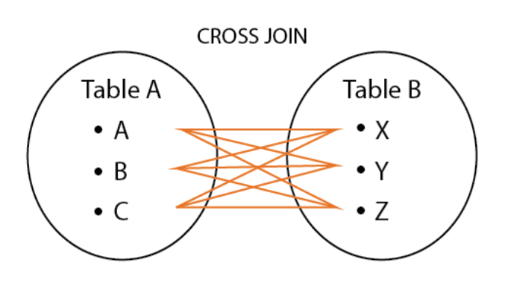
Joins

Slide 31
Transaction control language
COMMIT– This SQL TCL command will commit the running transaction
ROLLBACK – Rollback the current transaction
SAVE – You can set a save point so that, next time it will start from here
SET TRANSACTION – Specify the characteristics of the transactions

Slide 32
Stored procedure
A SQL stored procedure (SP) is a collection SQL statements and sql command logic, which is compiled and stored on the database. Stored procedues in SQL allows us to create SQL queries to be stored and executed on the server. Stored procedures can also be cached and reused.
Types
User defined stored procedures
System stored procedures

Slide 33
Function
Function is a stored program that you can pass parameters into and return a value.

Slide 34
Trigger
A SQL Server trigger is a piece of procedural code, like a stored procedure which is only executed when a given event happens
There are three main characteristics that make triggers different than stored procedures:
Triggers cannot be manually executed by the user.
There is no chance for triggers to receive parameters.
You cannot commit or rollback a transaction inside a trigger.

Slide 35
Trigger

